Slide 1
Bag of Tricks
for Efficient Text Classification
Piotr Bojanowski, Edouard Grave,
Armand Joulin, Tomas Mikolov
Facebook AI Research
(EACL ‘17)
Kang Cho
goatjo2016@naver.com
Data Intelligence Lab, Korea University
2019.08.08

Slide 2
Problem Statement
How to classify sentences quickly
while maintaining state-of-the-art performances?

Slide 3
Previous work
[Bag of Words]
a. A simple and efficient baseline for sentence classification.
b. Train a linear classifier e.g., a logistic regression or an SVM.
Sentence = Can I buy a apple?
BOW = [ i my 〮 〮 〮 apple . ? ]
= [ 1 0 .〮 〮 〮 1 1 ]
Wx+b
Weight = [$w_{1} w_{2}$ 〮 〮 〮 $w_{n−1} w_{n }]$
Independent
- Linear classifiers do not share parameters among features and classes.
Difficult to generalize because of the problem of scarcity

Slide 4
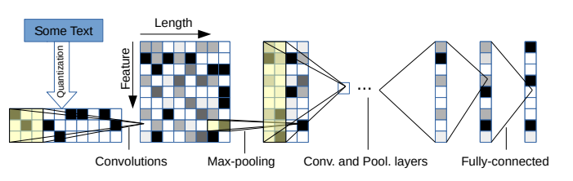
Previous work
[Character-level Convolution Networks]
(Xiang Zhang, Junbo Zhao, Yann LeCun. 2015)

Slide 5
Previous work
[Character-level Convolution Networks]
(Xiang Zhang, Junbo Zhao, Yann LeCun. 2015)

Slide 6
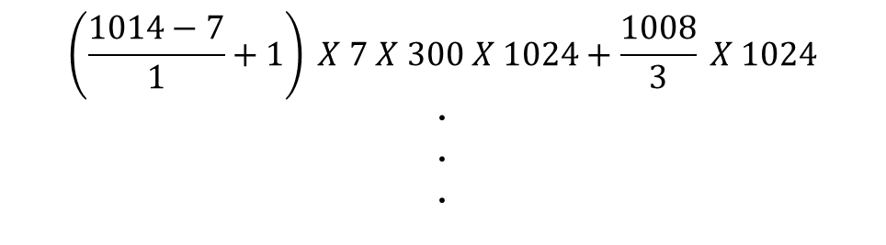
Experiment
[Character-level Convolution Networks]
Input
ConV Layer
Pooling Layer
Fully-Connected Layer
Embedding 300
t
kernel
Frame 1024
h
e
kernel
Fixed
Length
1014
〮
〮
〮
Frame 1024
$$\left(\frac{1014−7}{1}+1\right) X 7 X 300 X 1024+\frac{1008}{3} X 1024$$
〮
〮
〮

Slide 7
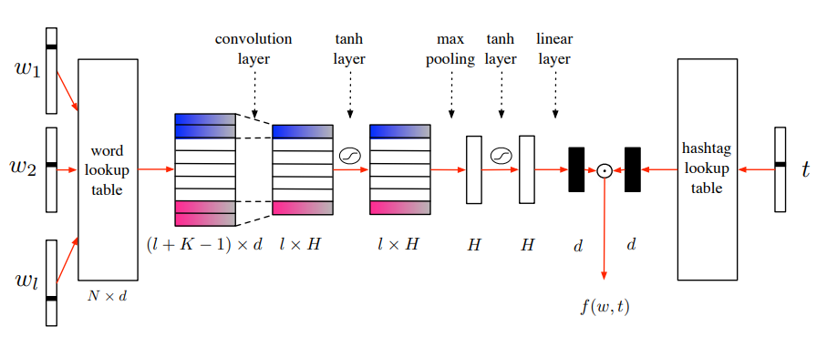
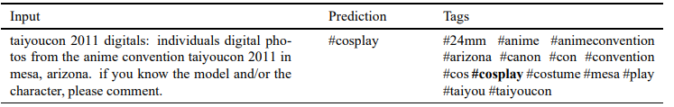
Previous work
[Tagspace]
(Jason Weston, Sumit Chopra, Keith Adams. 2014)

Slide 8
Previous work
[Tagspace]
(Jason Weston, Sumit Chopra, Keith Adams. 2014)

Slide 9
Contribution
1. They use n-grams to suggest a simple and efficient way
to reflect the context.
2. Their model learns very fast and has performance on par
with deep learning classifiers.
They overcome the problem that limits generalization
when some classes have very few examples.

Slide 10
Model
[FastText for text classification]
Word
representation
can
Embedding
Layer
i
Hidden
Layer
Output Layer
Score
Softmax
Very Negative
Negative
buy
〮〮〮
〮〮〮
〮〮〮
〮
〮
〮
a
Positive
Very Positive
apple
Average
?

Slide 11
Model
Sentence N-grams
Ungram : can, i, buy, a, ?, 〮 〮 〮 (Bag-of-Words)
Bigram : can_i, i_buy, buy_a, a_can, 〮 〮 〮
Trigram : can_i_buy, i_buy_a, buy_a_can, 〮 〮 〮
Sentence : Can I buy a apple?
Unigram. : [ can, i, buy, a, apple, ? ]
Bigram .: [ can_i, i_buy, buy_a, a_apple, apple_? ]
[ can, i, buy, a, apple, ?, can_i, i_buy, buy_a, a_apple, apple_? ]

Slide 12
Model
Sentence representation
Sentence
Sentence Representation
can : [ 0.01 0.02 -0.01 〮〮〮 0.03 ]
i : [ 0.11 0.02 0.00 〮〮〮 -0.01 ]
〮
〮
〮
buy_a : [ 0.02 0.01 0.04 〮〮〮 -0.02 ]
apple_? : [ 0.05 0.04 -0.07 〮〮〮 0.01 ]
Can I buy a apple?
AVERAGE
Sentence
Representation
: [ 0.11 0.03 -0.01 〮〮〮 0.01 ]
Notes:
말로 풀어서 –많이 구체적으로

Slide 13
Model
[FastText for text classification]
Word
representation
can
Embedding
Layer
i
Hidden
Layer
Output Layer
Score
Softmax
#sports
#health
buy
〮〮〮
〮〮〮
〮〮〮
〮
〮
〮
a
#society
#science
can
Average
If the number of classes is large,
the computation is expensive
?

Slide 14
Model
[Hierarchical Softmax]
Huffman Tree
3
Word | Encoding
#Society | 110
#science | 111
#health | 101
#sports | 100
#happy | 0
0
1
25
2
#happy
0
1
1
0
0
1
0
1
7
6
4
5
#sports
#health
#society
#science

Slide 15
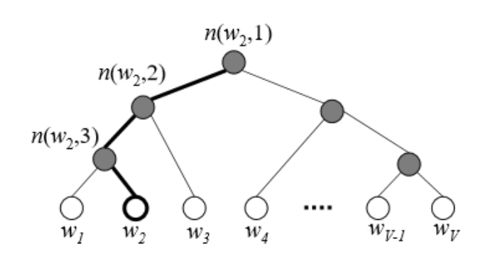











Model
[Hierarchical Softmax]
Output Layer
Hidden
Layer
$$n(w_{2},1)$$
Sigmoid
#Health
$$n(w_{2},2)$$
#sports
#health
〮 〮 〮
#society
#science
$$n(w_{2},3)$$
x x( )
Computational complexity
$$O\left(V\right){ O(log}_{2}{V})$$

Slide 16
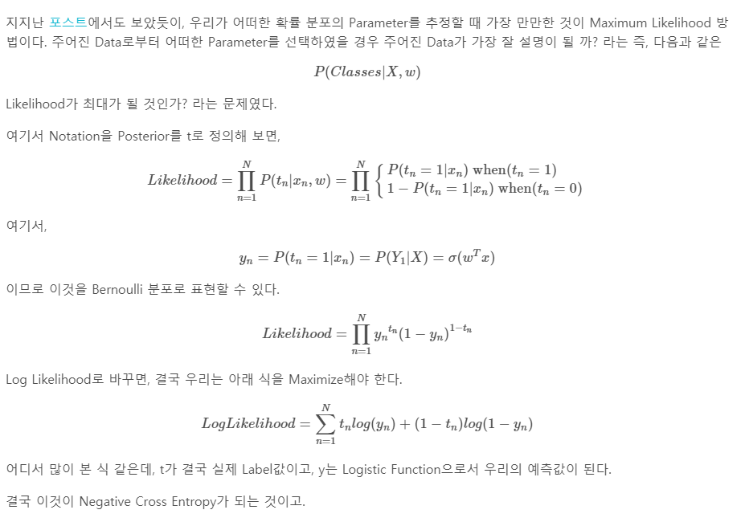
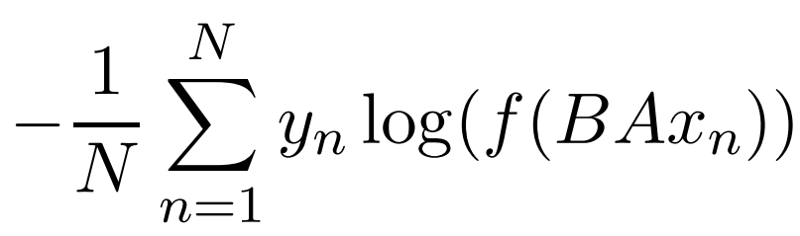


Model
[FastText for a sentence]
The number of classes is small
The number of classes is large
〮〮〮
〮
〮
〮
〮
〮
〮
〮〮〮
hierarchical
softmax
B
softmax
B
A
A
$$x_{n}$$
$$x_{n}$$
Negative log-likelihood

Slide 17
Experiment
Source Code
https://github.com/facebookresearch/fastText
Dataset
Data | Description | Training size(sentence)
AG | News articles | 120,000
Sogou | News articles | 450,000
DBP | Crowd-sourced community from wikipedia | 560,000
Yelp | Yahoo reviews / Answers | 560,000, 650,000 / 1,400,000
Amz | Amazon reviews | 3,000,000 / 3,600,000
IMDB | Movie reviews
YFCC100M | Yahoo Flickr Creative Commons | 91,188,648
Notes:
Data는 이전 논문이던지 어디던지 분명히 찾을 수 있다. 반드시 찾을것

Slide 18
Experiment
Source Code
https://github.com/facebookresearch/fastText
Dataset
Data | Description | Training size(sentence)
AG | News articles | 120,000
Sogou | News articles | 450,000
DBP | Crowd-sourced community from wikipedia | 560,000
Yelp | Yahoo reviews / Answers | 560,000, 650,000 / 1,400,000
Amz | Amazon reviews | 3,000,000 / 3,600,000
IMDB | Movie reviews
YFCC100M | Yahoo Flickr Creative Commons | 91,188,648
Notes:
Data는 이전 논문이던지 어디던지 분명히 찾을 수 있다. 반드시 찾을것

Slide 19
Experiment
Baseline
- The state-of-the-art models in each dataset.
Model Variant
Variations | Difference
fastText | Using unigram
fastText, bigram | Adding bigram

Slide 20
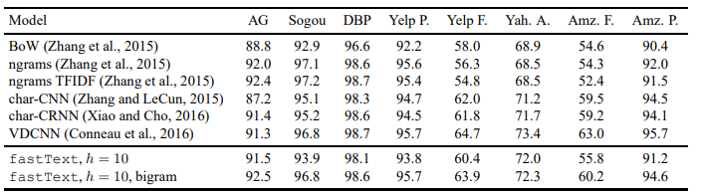
Experiment
[Sentiment analysis]
First,
Better than char-CNN and char-CRNN, worse than VDCNN.
Second,
Adding bigram information improves the performance by 1-4%.

Slide 21
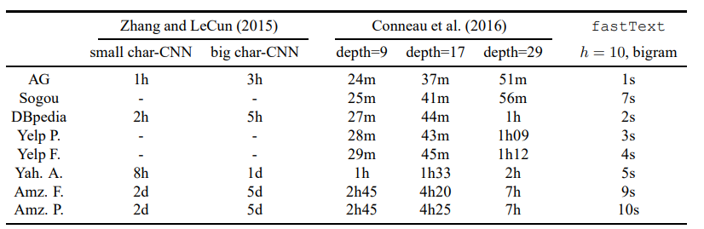
Experiment
[Sentiment analysis]

Slide 22
Experiment
[Sentiment analysis]

Slide 23
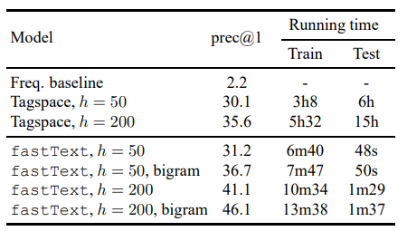
Experiment
[Tag prediction]
First,
The fastText model performs
Better than the baseline.
Second,
At test time, fastText is
much faster than Tagspace.

Slide 24



Experiment
Tagspace model
fastText model
Number of nodes
Sentence
representation
$$n(w_{2},1)$$
Sigmoid
$$n(w_{2},2)$$
$$n(w_{2},3)$$
Embedding

Slide 25
Conclusion
Their model obtains performance on par with recently proposed methods, while being much faster.
Their model is shallower than the baseline models.
They dramatically reduce computational complexity
by hierarchical softmax when the number of classes is large.
Notes:
Deep neural networks이론이 더 높은 representational power를 현재 shallow model보다 가지고있지만, 감정분석과 같은 간단한 분류믄제같은경우 그것을 평가할때 가장 적합한것이 무엇인지는 불명확하다

Slide 26
Q&A
Q & A
Notes:
FastText 수정사항 embedding
논문두개합치기
해싱 어떻게든
실험은 분리, / 정확한설명덧붙어ㅕ서
Task 각각에 대해 간단하게

